Slide 1

Sinhgad College of Engineering, Pune
GROUP NO :- 6B
Guided By:-
Presented by-: Roll.no
1. Darshan Khairnar 106031
2. Swarna Makune 106032
3. Parth Pawar 106033
4. Shubham Godambe 106034
5. Purva Dhokarikar 106035
6. Prathamesh Musale 106036
7. Suraj Sidankar 106037
Mrs.H.A. Navare

Slide 2
Sinhgad College of Engineering, Pune
CONTENTS
1.MOTIVATION
2. AIM
3. INTRODUCTION
4. EXAMPLE DIAGRAM
5. IMPLEMENTATION
6.FLOW CHART
7.TOOLS & TECHNOLOGY
8.RESULT
9.CONCLUSION
10.FUTURE SCOPE
11.REFERENCE

Slide 3
Sinhgad College of Engineering, Pune
MOTIVATION
To develop a tool which can do advertisement in more illustrative way and will overtake the boring advertising pamphlets
To develop a tool which can make client easily understand what the service is about in less words in visual format.

Slide 4
Sinhgad College of Engineering, Pune
AIM
*Breakdown of large and boring texts into illustrative way with less frequent words using wordcloud .

Slide 5
Sinhgad College of Engineering, Pune
INTRODUCTION
A Word Cloud is a collection or cluster of words depicted in different sizes.
The bigger and bolder the word appears, the more often it is selected/voted for by an audience member.
Word Clouds are a powerful way to visualise what your audience really thinks about a topicT

Slide 6
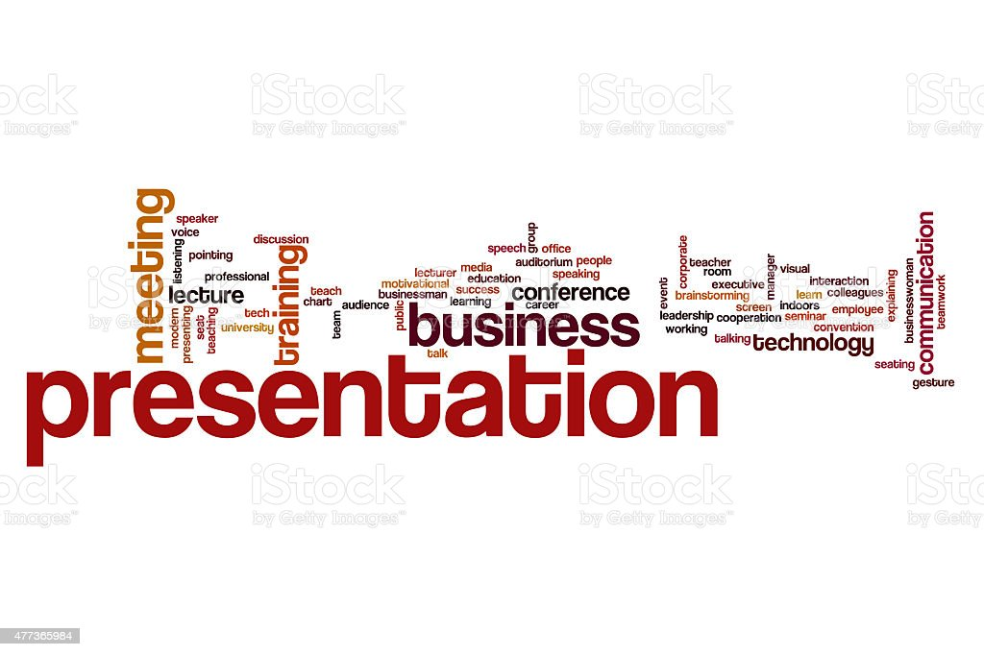
Sinhgad College of Engineering, Pune
Example diagram

Slide 7
Sinhgad College of Engineering, Pune
IMPLEMENTATION
1.What is the use of WordCloud?
Word Clouds are visual displays of text data – simple text analysis. Word Clouds display the most prominent or frequent words in a body of text.
2.WORDCLOUD is used in advertising pamphlets and in hoarding that can be seen on various shops.
3.It is also used in product advertising and marketing purpose

Slide 8

FLOW CHART
Selecting the Dataset
Selecting the text and amount of text for word cloud
Check for null values
Adding text to a variable
Creating the word cloud
Plotting the word cloud
end

Slide 9


Sinhgad College of Engineering, Pune
Tools and technology
1.Computer language used – Python (Version 3.10)
2.Integrated Development Learning Environment (IDLE )used -
a. Vs Code,
b. Pycharm
3.Module Required – : a.Matplotlib ,
b.wordcloud,
c.Numpy .

Slide 10
Sinhgad College of Engineering, Pune
USE OF LIBRARIES
1.MATPLOTLIB :-
Matplotlib is a Python library that helps in visualizing and analyzing the data and helps in better understanding of the data with the help of graphical, pictorial visualizations that can be simulated using the matplotlib library
2.WORDCLOUD :-
A word cloud (also called tag cloud or weighted list) is a visual representation of text data. Words are usually single words, and the importance of each is shown with font size or color. Python fortunately has a wordcloud library allowing to build the
3.NUMPY :-
NumPy is a Python library used for working with arrays. It also has functions for working in domain of linear algebra, fourier transform, and matrices. NumPy was created in 2005 by Travis Oliphant. It is an open source project and you can use it freely.

Slide 11
Sinhgad College of Engineering, Pune
FUTURE SCOPE
1. In future, some automatic color selection for different words according to their size and occurrence in the text can be developed.
2. In future, animations can be added to word cloud to improve the presentation of information to please the audience.
3. In future, we can add auto selection of the shape (png) of the word cloud using an A.I. that analysis the text for doing so.
4. It can be made convenient for even small scale industries to use it.

Slide 12
Sinhgad College of Engineering, Pune
RESULT
1. Analysing customer and employee feedback.
2.Identifying new SEO keywords to target.

Slide 13
Sinhgad College of Engineering, Pune
RESULT
1.Examlpe article
Milk is a very crucial part of our daily diet. It has great nourishing value as it contains several nutrients like calcium, proteins, potassium, phosphorous and many vitamins. Therefore it becomes an essential part of every kid’s life. Milk is not only important for growing children but also for people of all age groups.
We get milk from mostly cows or buffaloes. There is also other milk giving animals like sheep, goats, and camels. Yogurt, cheese, and chocolates are also milk products.
Milk makes our bones strong, provides us with energy and is even recommended for improving memory. Milk also prevents many diseases in this way. Though milk has countless benefits, people ignore them and continue living their life in an unhealthy way.

Slide 14
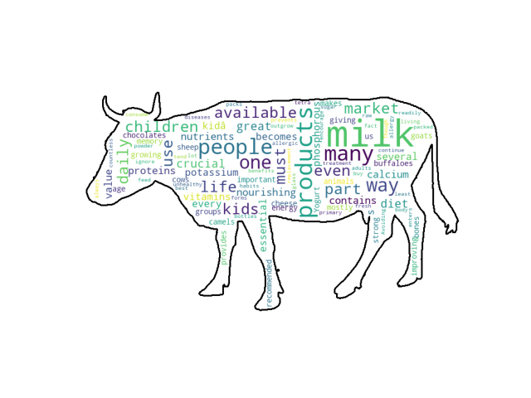
Sinhgad College of Engineering, Pune
RESULT
Illustration using wordcloud

Slide 15
Sinhgad College of Engineering, Pune
CONCLUSION
Understand what your audience/employees feel about a topic/situation
Your audience can summarise their view of a topic
Allows you to identify what is important to your audience
You can measure audience understanding of a topic

Slide 16
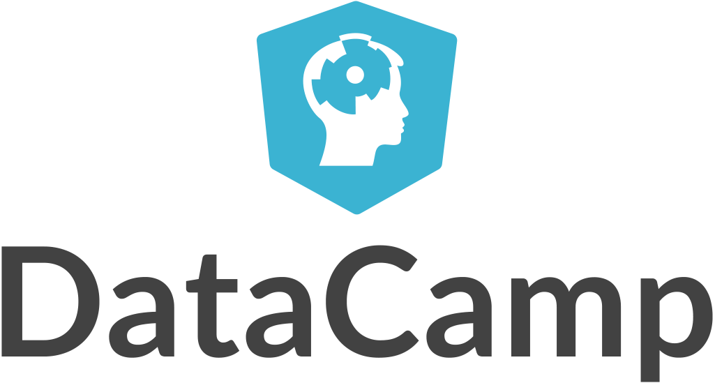

Sinhgad College of Engineering, Pune
REFERENCE
Used data from Datacamp.com
Youtube Channel for reference-: Python Enthusiast
Photo Gallery used -: Pinterest.

Slide 17
THANK YOU

